Slide 1
Ray Tracing (1)
RENDERING : Global Illumination

Slide 2
What issues must be addressed by a 3D rendering system?
3D scene representation
3D viewer representation
Visible surface determination
Lighting simulation
Notes:
In order to implement this algorithm we had to address these six issues.

Slide 3
What issues must be addressed by a 3D rendering system?
3D scene representation
3D viewer representation
Visible surface determination
Lighting simulation
How do we compute the radiance for each sample ray?
Let’s improve it
Notes:
In order to implement this algorithm we had to address these six issues.

Slide 4
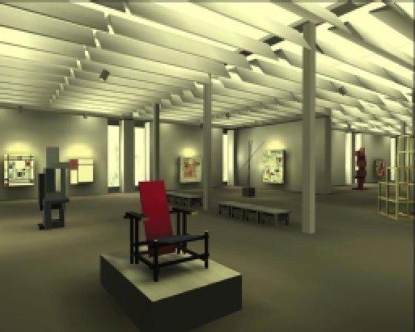
Effects needed for realism
Shadows
Reflections (Mirrors)
Transparency
Interreflections
Detail (Textures etc.)
Complex Illumination
Realistic Materials
And many more
Notes:
In order to implement this algorithm we had to address these six issues.

Slide 5
Reading
Hill, Chapter 14, Sections 14.1 to 14.5
Hill, Chapter 14, Sections 14.7.1 and 14.7.2

Slide 6
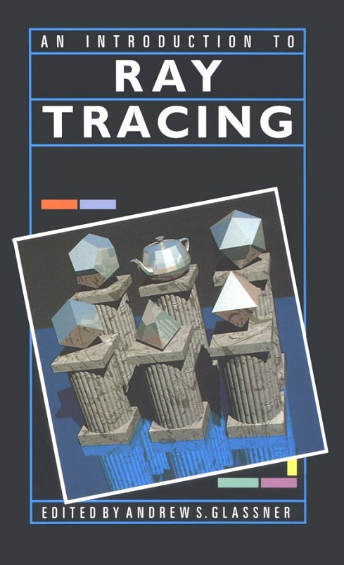
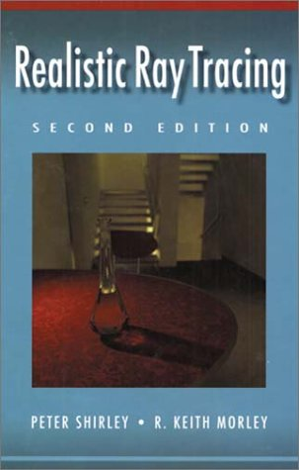
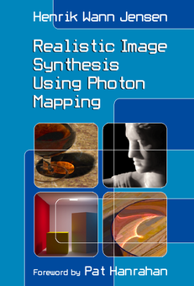
References
Hill Chapter 14
Specialized books:
Online resources
http://www.irtc.org/
http://www.acm.org/tog/resources/RTNews/html/
http://www.povray.org/
http://www.siggraph.org/education/materials/HyperGraph/raytrace/rtrace0.htm
http://www.siggraph.org/education/materials/HyperGraph/raytrace/rt_java/raytrace.html

Slide 7
Graphics Pipeline Overview
Properties of the Graphics Pipeline
    Primitives are processed one at a time
    All analytic processing early on
    Sampling occurs late
    Minimal state required
    ( immediate mode rendering)
    Processing is forward-mapping

Slide 8
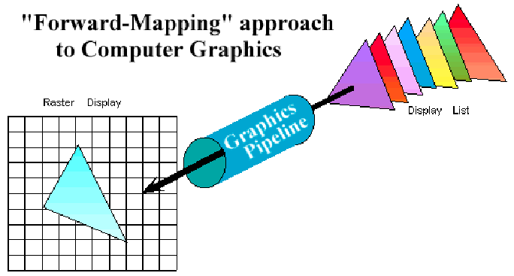

Slide 9
Alternative Approaches
There are other ways to compute views of scenes defined by geometric primitives.
One of the most common is ray-casting. Ray-casting searches along lines of sight, or rays, to determine the primitive that is visible along it. from the eye through the pixel.

Slide 10
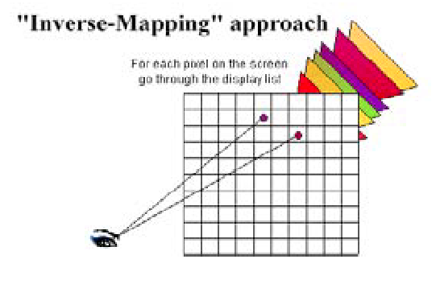

Slide 11
Properties of ray-casting:
Go through all primitives at each pixel
Sample first
Analytic processing afterwards
Requires a display list

Slide 13
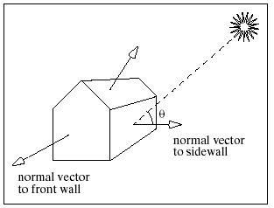
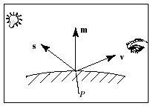
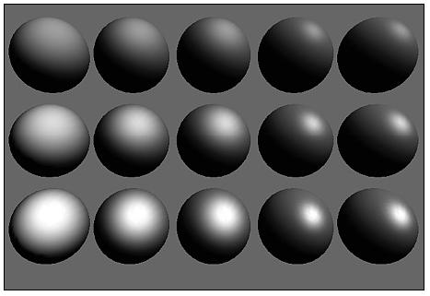
Lighting Simulation
Direct illumination
Polygon shading
Ray casting
Global illumination
Ray tracing
Radiosity
Photon Mapping
(…)
Notes:
In order to implement this algorithm we had to address these six issues.

Slide 14
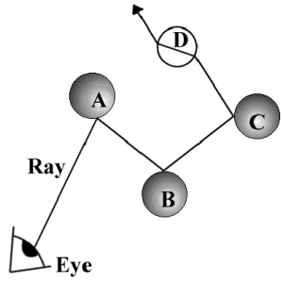
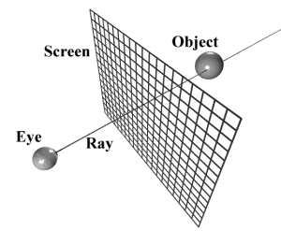
Ray Tracing
Notes:
In order to implement this algorithm we had to address these six issues.

Slide 15
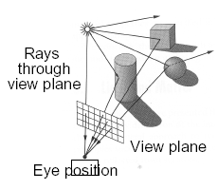
The color of each pixel on the view plane depends on the radiance emanating from visible surfaces
Simplest method is Ray Casting
Notes:
In order to implement this algorithm we had to address these six issues.

Slide 16
Ray Casting / Ray Tracing
Iterate over pixels, not objects.
Effects that are difficult with Z-buffer, are easy with ray tracing: shadows, reflections, transparency, procedural textures and objects.
Assume image plane is placed in the virtual space
Direct illumination
Polygon shading
Ray casting
Global illumination
Ray tracing
Notes:
In order to implement this algorithm we had to address these six issues.

Slide 17
RAY CASTING
Shoot rays through pixels into the world
For each pixel:
  Find closest intersection in scene
  Evaluate illumination model to color pixel
Notes:
In order to implement this algorithm we had to address these six issues.

Slide 18
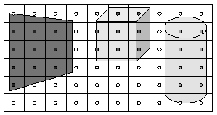
RAY CASTING
For each sample …
Construct ray from eye position through view plane
Find first surface intersected by ray through pixel
Compute color sample based on surface radiance
Notes:
In order to implement this algorithm we had to address these six issues.

Slide 19
Ray Casting
Simple implementation:
Image RayCast (Camera camera, Scene scene, int width, int height)
{
  Image image = new Image(width, height);
  for (int i = 0; i < width; i++) {
    for (int j = 0; j < height; j++) {
      Ray ray = ConstructRayThroughPixel(camera, i, j);
      Intersection hit = FindIntersection(ray, scene);
      image[i][j] = GetColor(hit);
    }
  }
  return image;
}
Notes:
In order to implement this algorithm we had to address these six issues.

Slide 20
Ray Casting
Simple implementation:
Image RayCast (Camera camera, Scene scene, int width, int height)
{
  Image image = new Image(width, height);
  for (int i = 0; i < width; i++) {
    for (int j = 0; j < height; j++) {
      Ray ray = ConstructRayThroughPixel(camera, i, j);
      Intersection hit = FindIntersection(ray, scene);
      image[i][j] = GetColor(hit);
    }
  }
  return image;
}
Notes:
In order to implement this algorithm we had to address these six issues.

Slide 21
Ray Casting
Simple implementation:
Image RayCast (Camera camera, Scene scene, int width, int height)
{
  Image image = new Image(width, height);
  for (int i = 0; i < width; i++) {
    for (int j = 0; j < height; j++) {
      Ray ray = ConstructRayThroughPixel(camera, i, j);
      Intersection hit = FindIntersection(ray, scene);
      image[i][j] = GetColor(hit);
    }
  }
  return image;
}
Notes:
In order to implement this algorithm we had to address these six issues.

Slide 22
Ray Casting
Simple implementation:
Image RayCast (Camera camera, Scene scene, int width, int height)
{
  Image image = new Image(width, height);
  for (int i = 0; i < width; i++) {
    for (int j = 0; j < height; j++) {
      Ray ray = ConstructRayThroughPixel(camera, i, j);
      Intersection hit = FindIntersection(ray, scene);
      image[i][j] = GetColor(hit);
    }
  }
  return image;
}
Notes:
In order to implement this algorithm we had to address these six issues.

Slide 23
Ray Casting
Simple implementation:
Image RayCast (Camera camera, Scene scene, int width, int height)
{
  Image image = new Image(width, height);
  for (int i = 0; i < width; i++) {
    for (int j = 0; j < height; j++) {
      Ray ray = ConstructRayThroughPixel(camera, i, j);
      Intersection hit = FindIntersection(ray, scene);
      image[i][j] = GetColor(hit);
    }
  }
  return image;
}
Notes:
In order to implement this algorithm we had to address these six issues.

Slide 24
Ray Casting
Simple implementation:
Image RayCast (Camera camera, Scene scene, int width, int height)
{
  Image image = new Image(width, height);
  for (int i = 0; i < width; i++) {
    for (int j = 0; j < height; j++) {
      Ray ray = ConstructRayThroughPixel(camera, i, j);
      Intersection hit = FindIntersection(ray, scene);
      image[i][j] = GetColor(hit);
    }
  }
  return image;
}
Notes:
In order to implement this algorithm we had to address these six issues.

Slide 25
Notes:
In order to implement this algorithm we had to address these six issues.

Slide 26
Image image = new Image (width, height);
Notes:
In order to implement this algorithm we had to address these six issues.

Slide 27
Ray ray = ConstructRayThroughPixel (camera, i, j);
Notes:
In order to implement this algorithm we had to address these six issues.

Slide 28
Intersection hit = FindIntersection (ray, scene);
Notes:
In order to implement this algorithm we had to address these six issues.

Slide 29
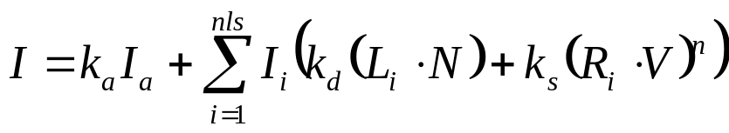
image[i][j] = GetColor (hit);
Notes:
In order to implement this algorithm we had to address these six issues.

Slide 30
image[i][j] = GetColor (hit);
Notes:
In order to implement this algorithm we had to address these six issues.

Slide 31
Ray ray = ConstructRayThroughPixel (camera, i, j);
Notes:
In order to implement this algorithm we had to address these six issues.

Slide 32
Intersection hit = FindIntersection (ray, scene);
Notes:
In order to implement this algorithm we had to address these six issues.

Slide 33
image[i][j] = GetColor (hit);
Notes:
In order to implement this algorithm we had to address these six issues.

Slide 34
image[i][j] = GetColor (hit);
Notes:
In order to implement this algorithm we had to address these six issues.

Slide 35
Ray ray = ConstructRayThroughPixel (camera, i, j);
Notes:
In order to implement this algorithm we had to address these six issues.

Slide 36
Intersection hit = FindIntersection (ray, scene);
Notes:
In order to implement this algorithm we had to address these six issues.

Slide 37
image[i][j] = GetColor (hit);
Notes:
In order to implement this algorithm we had to address these six issues.

Slide 38
image[i][j] = GetColor (hit);
Notes:
In order to implement this algorithm we had to address these six issues.

Slide 39
Ray ray = ConstructRayThroughPixel (camera, i, j);
Notes:
In order to implement this algorithm we had to address these six issues.

Slide 40
Intersection hit = FindIntersection (ray, scene);
Notes:
In order to implement this algorithm we had to address these six issues.

Slide 41
image[i][j] = GetColor (hit);
Notes:
In order to implement this algorithm we had to address these six issues.

Slide 42
image[i][j] = GetColor (hit);
Notes:
In order to implement this algorithm we had to address these six issues.

Slide 43
RAY CASTING
Notes:
In order to implement this algorithm we had to address these six issues.

Slide 44




RAY CASTING
Direct
Direct
Remember: still direct illumination!
Notes:
In order to implement this algorithm we had to address these six issues.

Slide 45
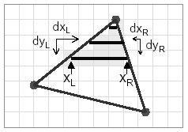
RAY CASTING
Comparison to scan-line (rasterization) algorithm:
Per-pixel evaluation, per-pixel rays (not scan-convert each object)
More complex shading, lighting effects possible
Notes:
In order to implement this algorithm we had to address these six issues.

Slide 46
Ray Casting
Simple implementation:
Image RayCast (Camera camera, Scene scene, int width, int height)
{
  Image image = new Image(width, height);
  for (int i = 0; i < width; i++) {
    for (int j = 0; j < height; j++) {
      Ray ray = ConstructRayThroughPixel(camera, i, j);
      Intersection hit = FindIntersection(ray, scene);
      image[i][j] = GetColor(hit);
    }
  }
  return image;
}
Notes:
In order to implement this algorithm we had to address these six issues.

Slide 47
Ray Casting
Simple implementation:
Image RayCast (Camera camera, Scene scene, int width, int height)
{
  Image image = new Image(width, height);
  for (int i = 0; i < width; i++) {
    for (int j = 0; j < height; j++) {
      Ray ray = ConstructRayThroughPixel (camera, i, j);
      Intersection hit = FindIntersection(ray, scene);
      image[i][j] = GetColor(hit);
    }
  }
  return image;
}
Notes:
In order to implement this algorithm we had to address these six issues.

Slide 48
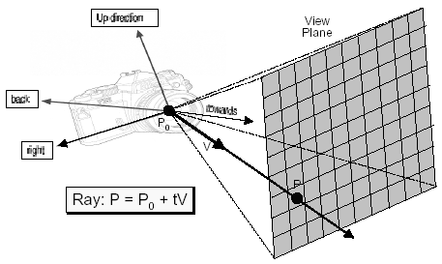
Constructing Ray Through a Pixel
Notes:
In order to implement this algorithm we had to address these six issues.

Slide 49
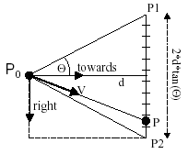
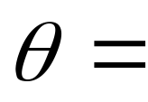
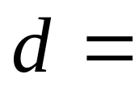

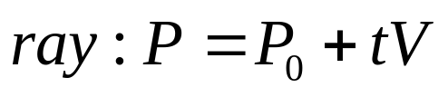
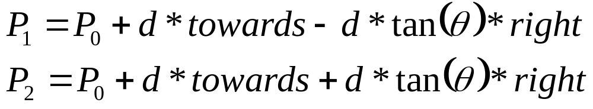
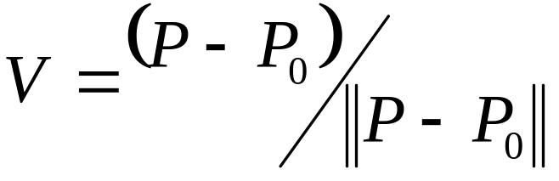
Constructing Ray Through a Pixel
2D example:
frustum half-angle
distance to view plane
Notes:
In order to implement this algorithm we had to address these six issues.

Slide 50
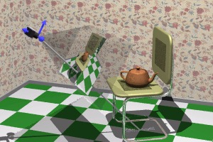
Perspective Camera
Eye point
Look-At Point
Up Vector
Horizontal FOV (degrees)
Up
Eye
Look-At

Slide 51
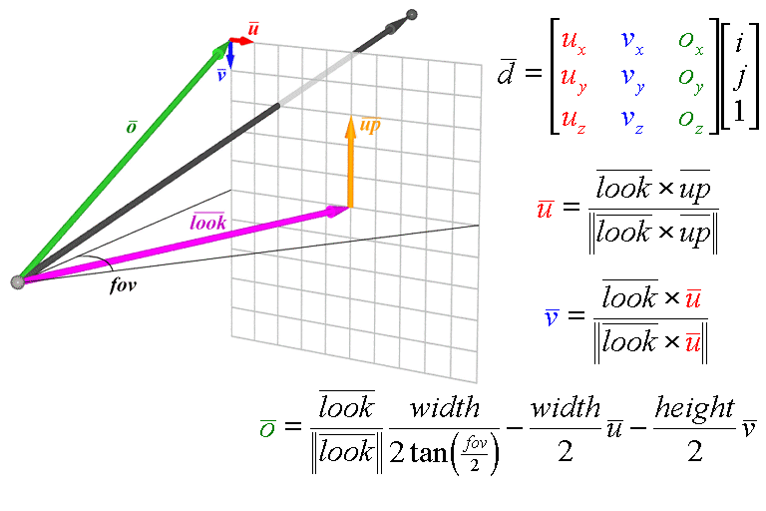
Perspective Ray Generation

Slide 52
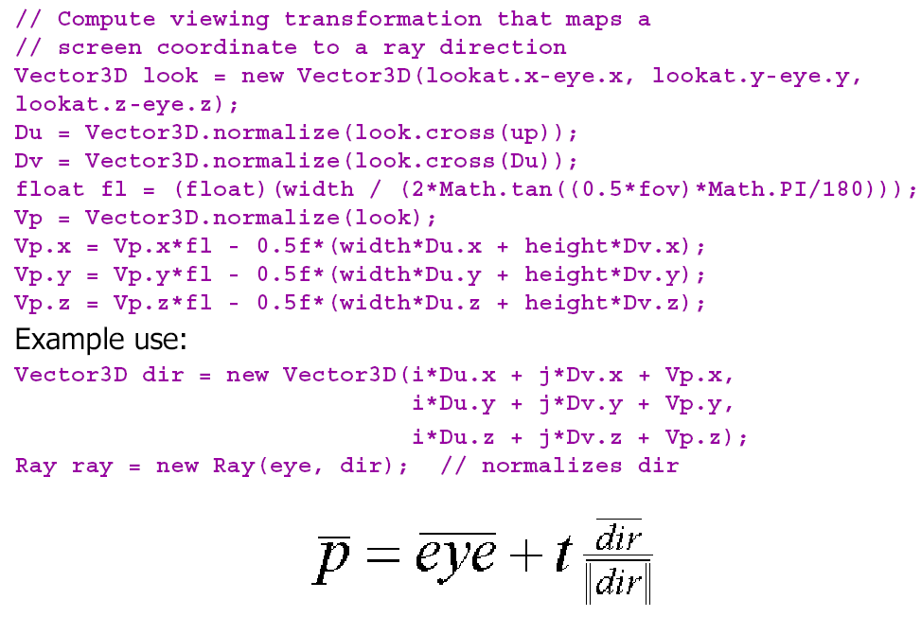
Perspective Ray Generation

Slide 53
Ray Casting
Simple implementation:
Image RayCast (Camera camera, Scene scene, int width, int height)
{
  Image image = new Image(width, height);
  for (int i = 0; i < width; i++) {
    for (int j = 0; j < height; j++) {
      Ray ray = ConstructRayThroughPixel (camera, i, j);
      Intersection hit = FindIntersection (ray, scene);
      image[i][j] = GetColor(hit);
    }
  }
  return image;
}
Notes:
In order to implement this algorithm we had to address these six issues.

Slide 54
Ray-Scene Intersection
Intersections with geometric primitives:
Sphere
Triangle
Groups of primitives (scene)
Notes:
In order to implement this algorithm we had to address these six issues.

Slide 55
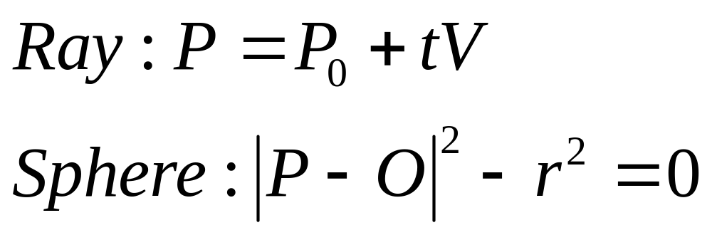
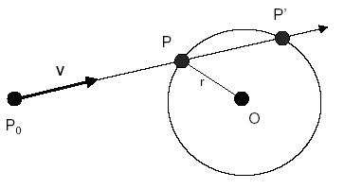
Ray-Sphere Intersection
Notes:
In order to implement this algorithm we had to address these six issues.

Slide 56
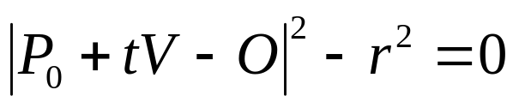

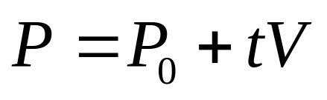
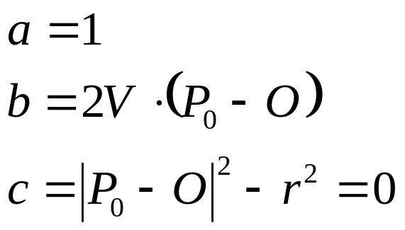
Ray-Sphere Intersection I
Algebraic Method
Substituting for P, we get:
Solve quadratic equation:
where:
Notes:
In order to implement this algorithm we had to address these six issues.

Slide 57
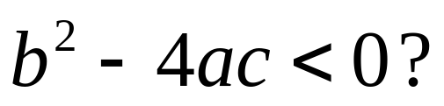
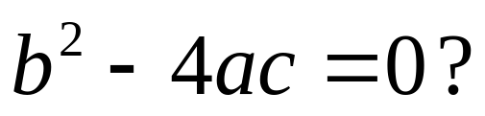
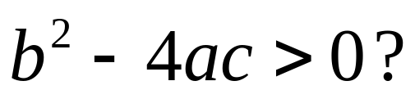
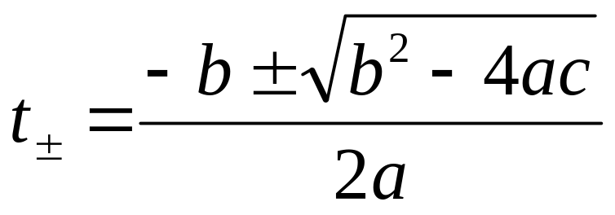
Ray-Sphere Intersection I
Algebraic Method
the ray and sphere do not intersect
ray grazes sphere
the smallest positive t corresponds to the intersection:
Notes:
In order to implement this algorithm we had to address these six issues.

Slide 58
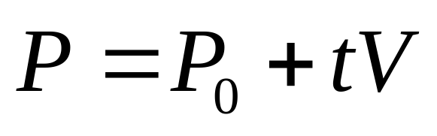
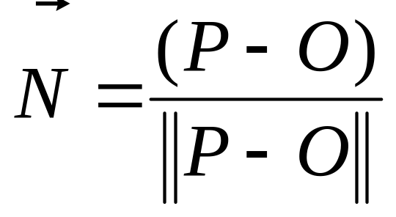
Ray-Sphere Intersection I
Algebraic Method
Intersection POINT (xi, yi, zi):
Intersection NORMAL:
the surface normal at the intersection point P is
DONE!
We are ready for lighting calculations!
Notes:
In order to implement this algorithm we had to address these six issues.

Slide 59
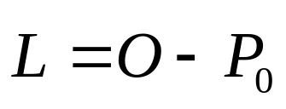
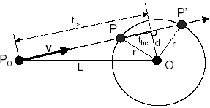
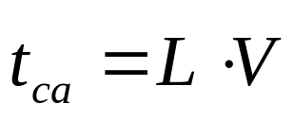
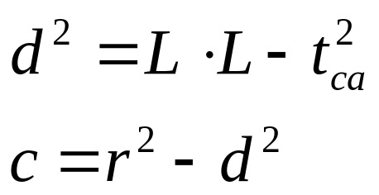
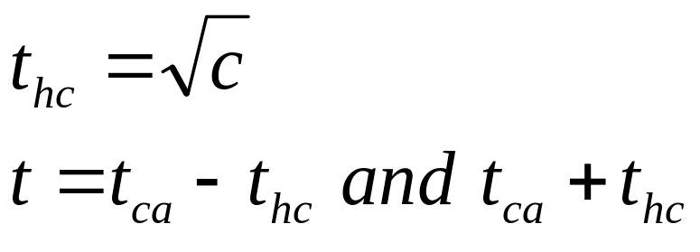
Ray-Sphere Intersection II
Geometric Method
Notes:
In order to implement this algorithm we had to address these six issues.

Slide 60
Ray-Sphere Intersection II
Geometric Method
Notes:
In order to implement this algorithm we had to address these six issues.

Slide 61
Early Rejection
The performance of ray casting is determined by how efficiently ray object intersections can be determined.
Let's re-think the series of computations used to determine the ray-sphere intersection while looking for ways to eliminate unnecessary work.

Slide 62
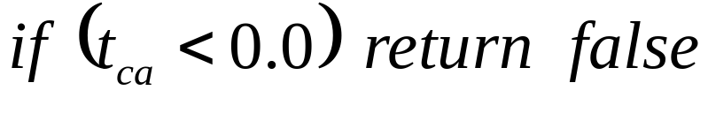
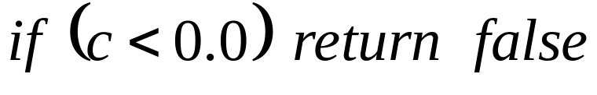
Ray-Sphere Intersection II
Geometric Method
Notes:
In order to implement this algorithm we had to address these six issues.

Slide 63
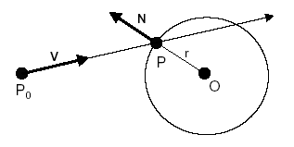
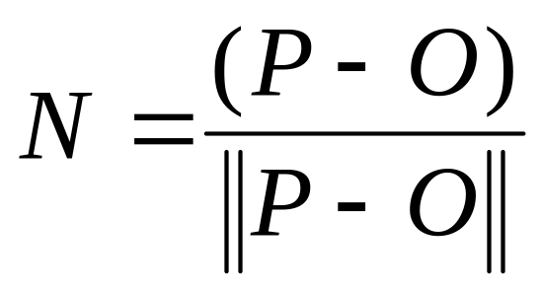
Ray-Sphere Intersection
Need normal vector at intersection
for lighting calculations
Notes:
In order to implement this algorithm we had to address these six issues.

Slide 64
Geometric vs. Algebraic
Algebraic is simple & generic
Geometric is more efficient
    Timely tests
    In particular for rays
    outside and pointing away

Slide 65
Recursive Ray-Casting
Starting from the viewing position, first compute the visible object along each ray.
Then compute the visibility of each light source from the visible surface point, using a new ray.
If there is an object between the light source and the object point it is in shadow, and we ignore the illumination from that source.
We can also model reflection and refraction similarly.

Slide 66
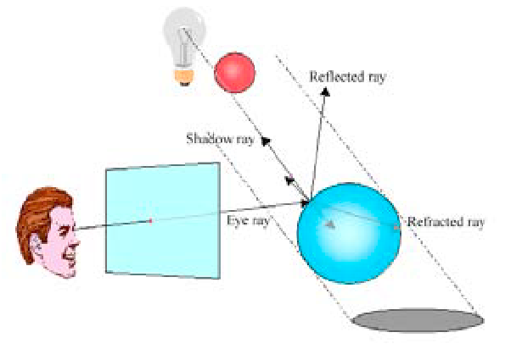
Recursive Ray-Casting: Shadows!
Similar strategy for reflection and refraction!

Slide 67
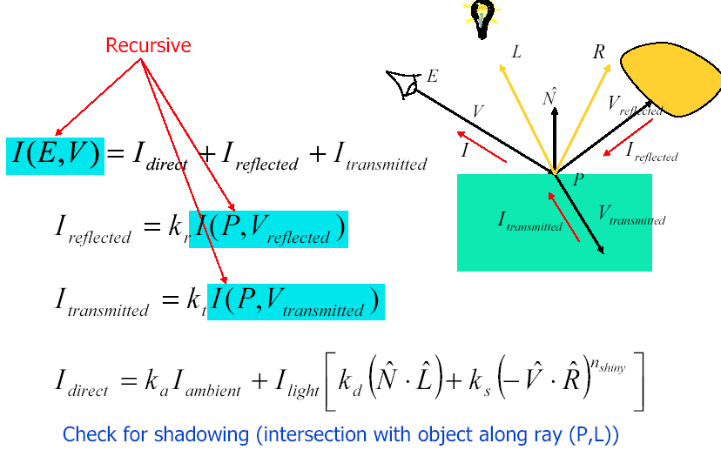
More later on…
Ray Tracing Illumination

Slide 68
Ray-Scene Intersection
Intersections with geometric primitives:
Sphere
Triangle
Groups of primitives (scene)
Notes:
In order to implement this algorithm we had to address these six issues.

Slide 69
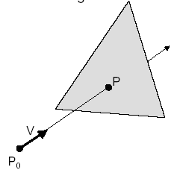
Ray-Triangle Intersection
Intersect ray with plane
Check if point is inside triangle
Notes:
In order to implement this algorithm we had to address these six issues.

Slide 70
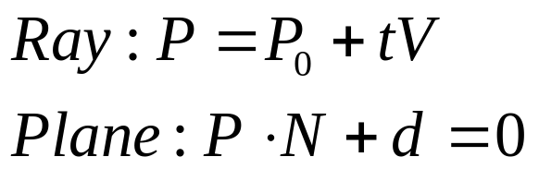
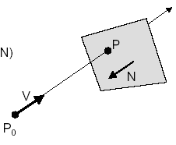


Ray-Plane Intersection
Algebraic Method
Substituting for P, we get:
Solution:
Notes:
In order to implement this algorithm we had to address these six issues.

Slide 71


Ray-Triangle Intersection I
Point inside triangle?
Algebraic Method
For each side of triangle:
end
Notes:
In order to implement this algorithm we had to address these six issues.

Slide 72


Ray-Triangle Intersection II
Point inside triangle?
Parametric Method
Notes:
In order to implement this algorithm we had to address these six issues.

Slide 73
Other Ray-Primitive Intersections
Cone, cylinder, ellipsoid:
Similar to sphere
Box
Intersect 3 front-facing planes, return closest
Convex Polygon
Same as triangle (check point-in-polygon algebraically)
Concave Polygon
Same plane intersection
More complex point-in-polygon test
Notes:
In order to implement this algorithm we had to address these six issues.

Slide 74
Ray-Scene Intersection
Intersections with geometric primitives:
Sphere
Triangle
Groups of primitives (scene)
Notes:
In order to implement this algorithm we had to address these six issues.

Slide 75

Ray-Scene Intersection
Notes:
In order to implement this algorithm we had to address these six issues.

